Slide 1

Presented by l s v s ramakrishna
AP22110010663
Srivenkatasivaramakrishna_lavu@srmap.edu.in
SRM UNIVERSITY
Andhra Pradesh
CYBER-SECUYRITY WITH KALI-LINUX

Slide 2
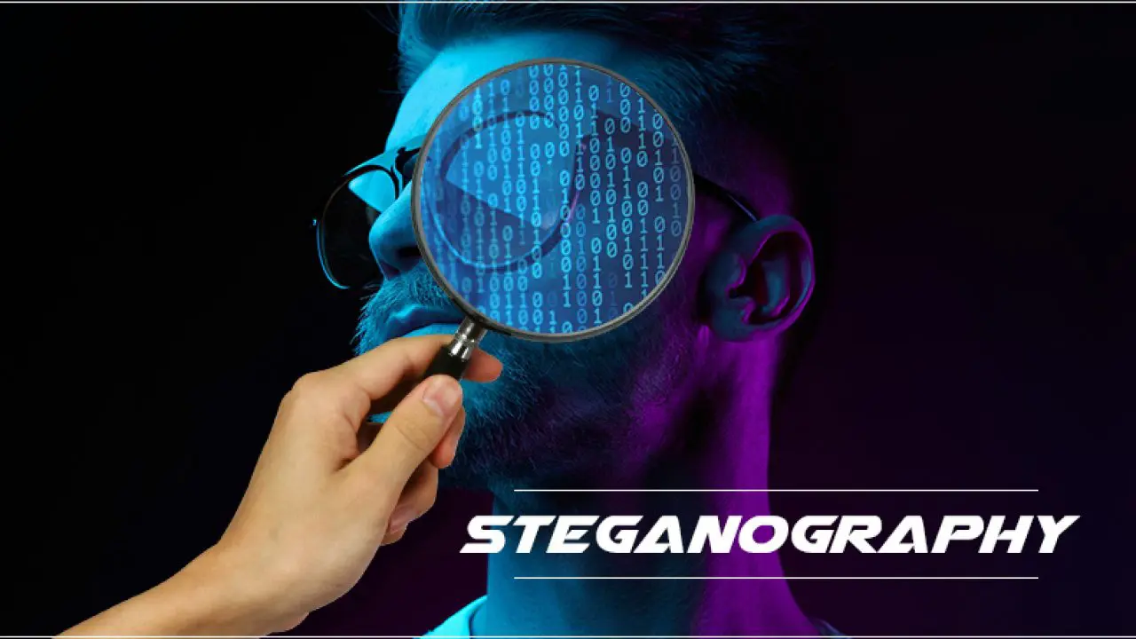

Slide 3

Problem statement
In the age of digital communication, the security and confidentiality of information have become critical. Traditional encryption methods, while effective, often attract unwanted attention. Image steganography, which involves embedding hidden messages within digital images, offers a more covert solution. However, existing methods face challenges in maintaining the quality of the image, ensuring robustness against detection, and maximizing the data embedding capacity.
This project aims to develop an advanced image steganography technique that enhances the embedding capacity and robustness while preserving the visual quality of the host image. The proposed method should be resistant to common steganalysis attacks and capable of embedding larger amounts of data without perceptible distortion to the image.

Slide 4
AGENDA
We need to find the data or text which is hidden in the image.
At final we need to find the text.
We conclude by our results
:

Slide 5

End users
The end users of an image steganography project could include:
Government and Military: For secure communication and data transmission.
Law Enforcement: In investigations requiring covert data exchange.
Journalists and Whistleblowers: Protecting sensitive information.
Corporate Professionals: Ensuring confidential communication.
General Public: Privacy enthusiasts or individuals needing secure messaging.
These users benefit from steganography's ability to hide information, offering confidentiality without drawing attention.

Slide 6
Process
Introduction to Image Steganography
Types of steganography
Process of embedding data
tools for steganography
How we transfer data safely and security aspects
Applications of steganography

Slide 7
Introduction to Image Steganography
Definition of Steganography
Significance in Digital Communication
Image Steganography Techniques
Steganography is the practice of concealing a message within another medium to ensure the confidentiality of the message. It involves hiding the existence of the message, unlike encryption where the goal is to secure the content.
Image steganography plays a vital role in secure communication by allowing covert data transmission within visual content, preventing unauthorized access. It enhances privacy and security in digital exchanges.
Techniques like spatial and frequency domain methods are commonly used in image steganography. Spatial domain involves directly manipulating pixel values, while frequency domain techniques alter the image in the frequency domain through transformations like FFT.

Slide 8
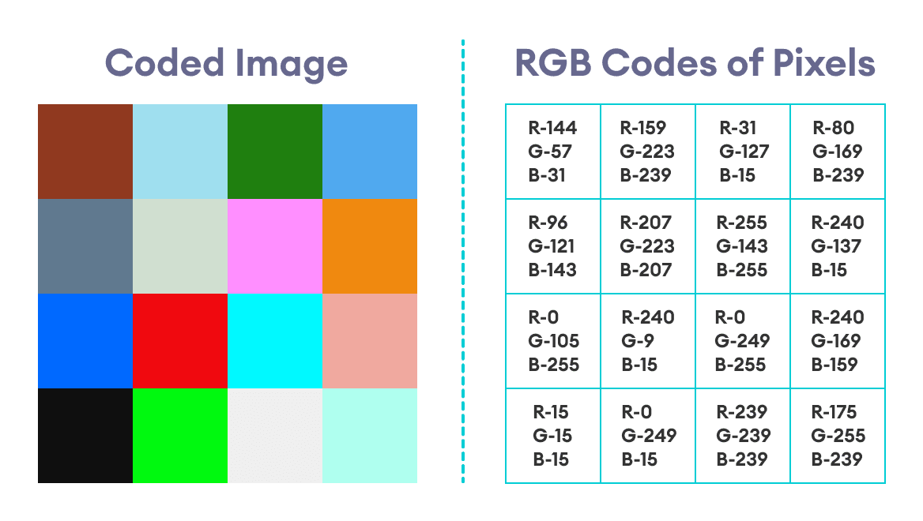
Types of Image Steganography
8bit vs RGB color Techniques
8 bit technique and RGB color mechanisms embed data directly into the image pixels, affecting the visual appearance. In contrast, frequency domain techniques modify the image's frequency components, often preserving the perceptual quality of the image.

Slide 9
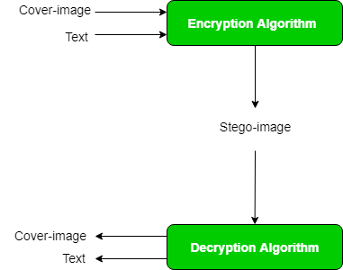
Process of Embedding Data
Data Embedding Process
Stego Image Generation
The process of embedding data in an image involves selecting cover image, encoding the secret data, embedding it seamlessly, and ensuring that the stego image appears normal to the eye.
Generating the stego image requires precise embedding techniques to hide information effectively. Careful selection of embedding locations and methods is crucial for successful steganographic encoding.

Slide 10
11
Tools for Image Steganography
Tool Name | Features
OpenStego | Supports various steganographic techniques
Steghide | Command-line tool for data embedding
OutGuess | Focuses on maximizing data capacity
Steganography Studio | User-friendly interface for beginners

Slide 11
Security Aspects and Challenges
Security Implications
Challenges in Image Steganography
Countermeasures
While steganography can enhance data security, it also poses risks such as covert communication, data leakage, and potential misuse by malicious actors.
Challenges include steganalysis methods which aim to detect hidden data, increasing the robustness of embedding techniques, and ensuring the integrity of the stego image.
To mitigate risks, robust encryption in conjunction with steganography can enhance the security of hidden data. Implementing authentication mechanisms can also validate the integrity of transmitted information.

Slide 12
Applications of Image Steganography
40%
30%
30%
Data Hiding
Watermarking
Authentication
Data hiding applications involve concealing sensitive information within images for secure communication, with a significant 40% usage rate.
Digital watermarking is utilized for copyright protection and content authentication, with a usage rate of 30% in image steganography.
Image steganography plays a role in authentication processes to verify the integrity and origin of transmitted images, comprising 30% of its applications.

Slide 13
links
https://github.com/ramulavu/Steganography-project

Slide 14


